Slide 1
Student’s name: Violet Mwangi Institution affiliation: Sevennet Boot Camp Course Name: Data Analytics Instructor’s Name :Mr Raghuvendra Anshu Date:01/02/2024
FINAL EXCEL PROJECT-MOVIE DATASET.

Slide 2
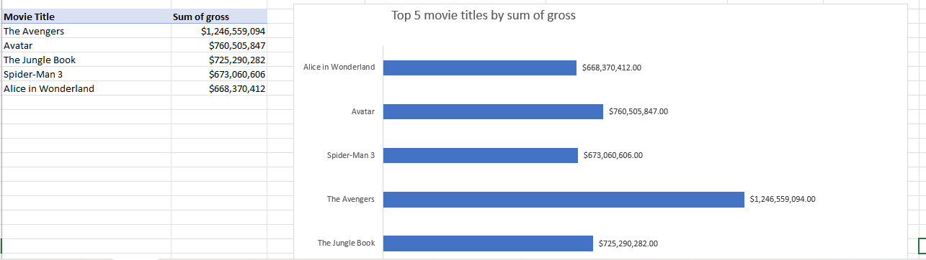
Top 5 movie titles by sum of gross is being used to show which movies amounted the largest gross income for future production of movies.

Slide 3
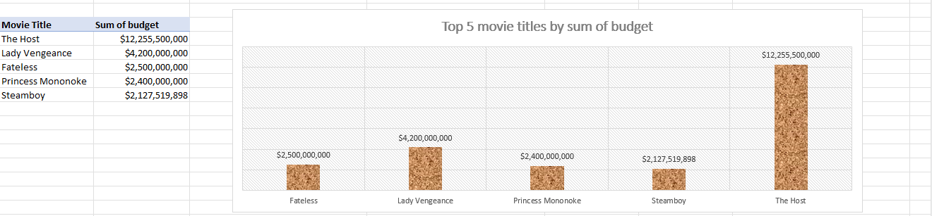
Top 5 movie titles by sum of budget is used to show the limit at which the expenditure of a movie can go and while using the first data can show if the expenditure did lead to a significant gross.

Slide 4
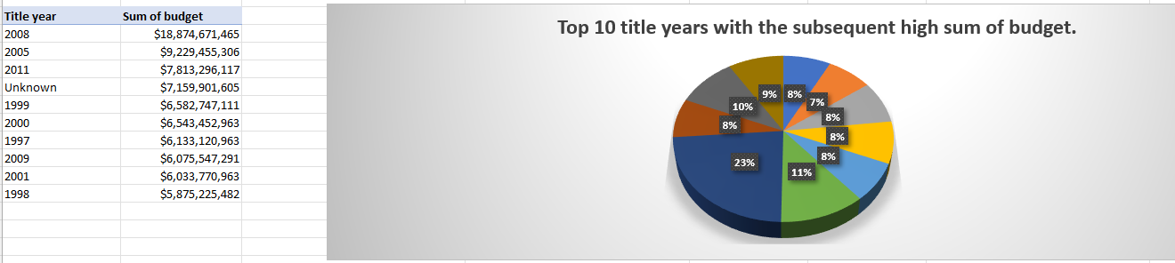
Top 10 years by sum of budgetshows that though there is not a distinct pattern increase in the budget over the years, it still shows that as the years progress the budget may also increase.

Slide 5
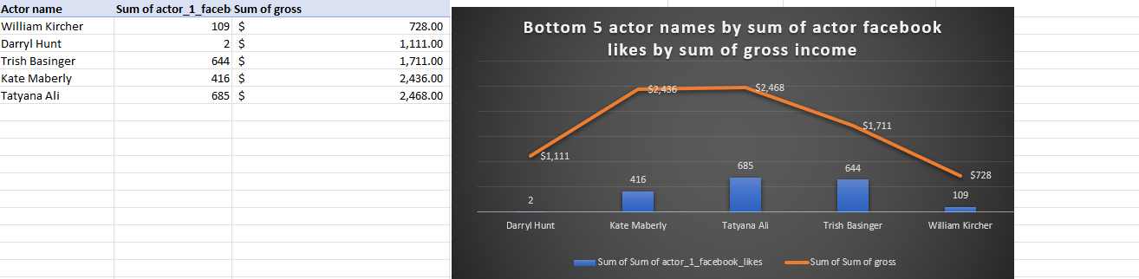
The two slides of data are being used to show if there is a direct corelation between actor names their facebook likes and the income made from the movies they starred in. There is a clear indication that with a large sum of facebook likes there will be a higher income of gross.
There is a clear indication that with a large sum of facebook likes there will be higher income in gross.

Slide 6
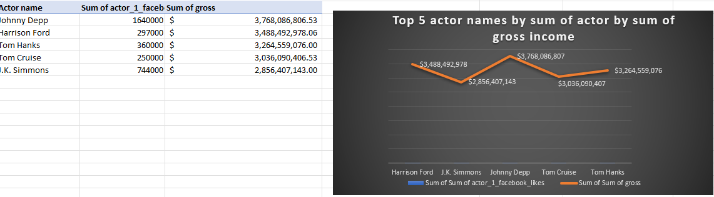
The two slides of data are being used to show if there is a direct corelation between actor names their facebook likes and the income made from the movies they starred in. There is a clear indication that with a large sum of facebook likes there will be a higher income of gross. There is a clear indication that with a large sum of facebook likes there will be higher income in gross.

Slide 7
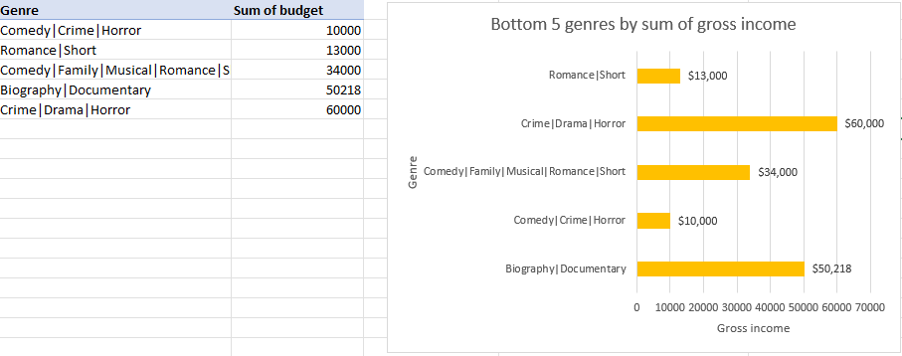
Bottom 5 genres by sum of gross is used to show which genres do not do well and select better genres to focus on to increase gross.

Slide 8
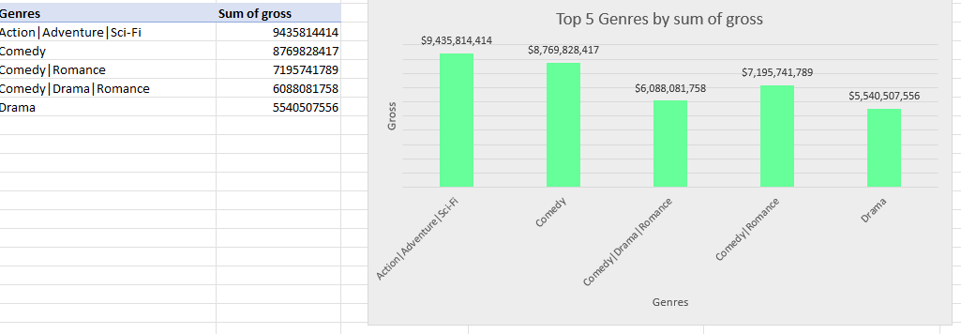
Top 5 genres by sum of gross shows which genres have brought in more gross as compared to other genres.

Slide 9
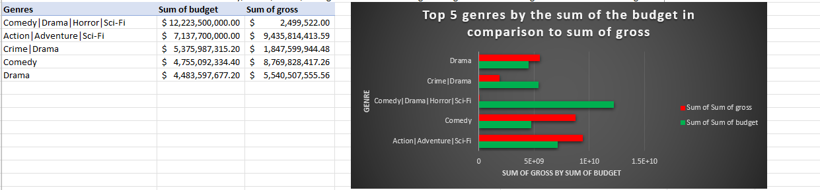
Top 5 genres by the sum of the budget in comparison to sum of gross which shows that despite having a large budget the sum of the gross income maybe lower than expected such as in the comedy/drama/horror/sci-fi genres that had the largest budget but the lowest gross to all the other five genres.

Slide 10
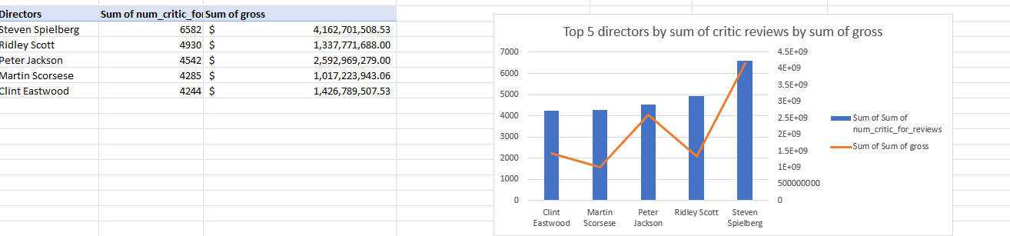
Top 5 directors with the highest sum of critic reviews by sum of gross with the comparison between the critic reviews and the sum gross for different directors to indicate which director produces the quality movies.

Slide 11
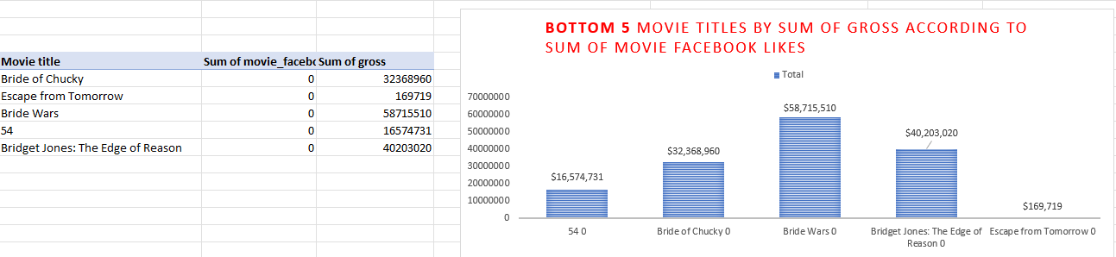
Bottom 5 movie titles based on the lowest facebook likes showing the gross income which when compared to the five highest movie titles based on the high face book likes clerarly shows with higher facebook likes the gross stands to be higher which can lead to good marketing for the movies and in turn higher gross.

